Slide 1
Can Blog Communication Dynamics be Correlated
with Stock Market Activity?
DSCI560
Instructor：Young Cho, Ph.D.
Yifan Yang
8386626867

Slide 2
INTRODUCTION and abstract
Highlights from what I read：
This paper has two key contributions: (a) identifying the information roles and contextual attributes of four technology companies, (b) modeling them as a regression problem in a support vector machine framework and using stock movements to train the model
introduction
The main contribution of this paper is a simple framework for dynamic modeling of contextual human-to-human communication.
These contextual features are: number of posts, number of comments, length and time to reply to comments, intensity of comments, and the information roles available to different people (early responders/late teasers, loyalists/outliers).
These results are validated by using two baseline methods: firstly aware of the situation by comparing it to non-context, and secondly using a linear combination of contextual features.
SECTION TITLE | 2
SECTION TITLE | 2

Slide 3
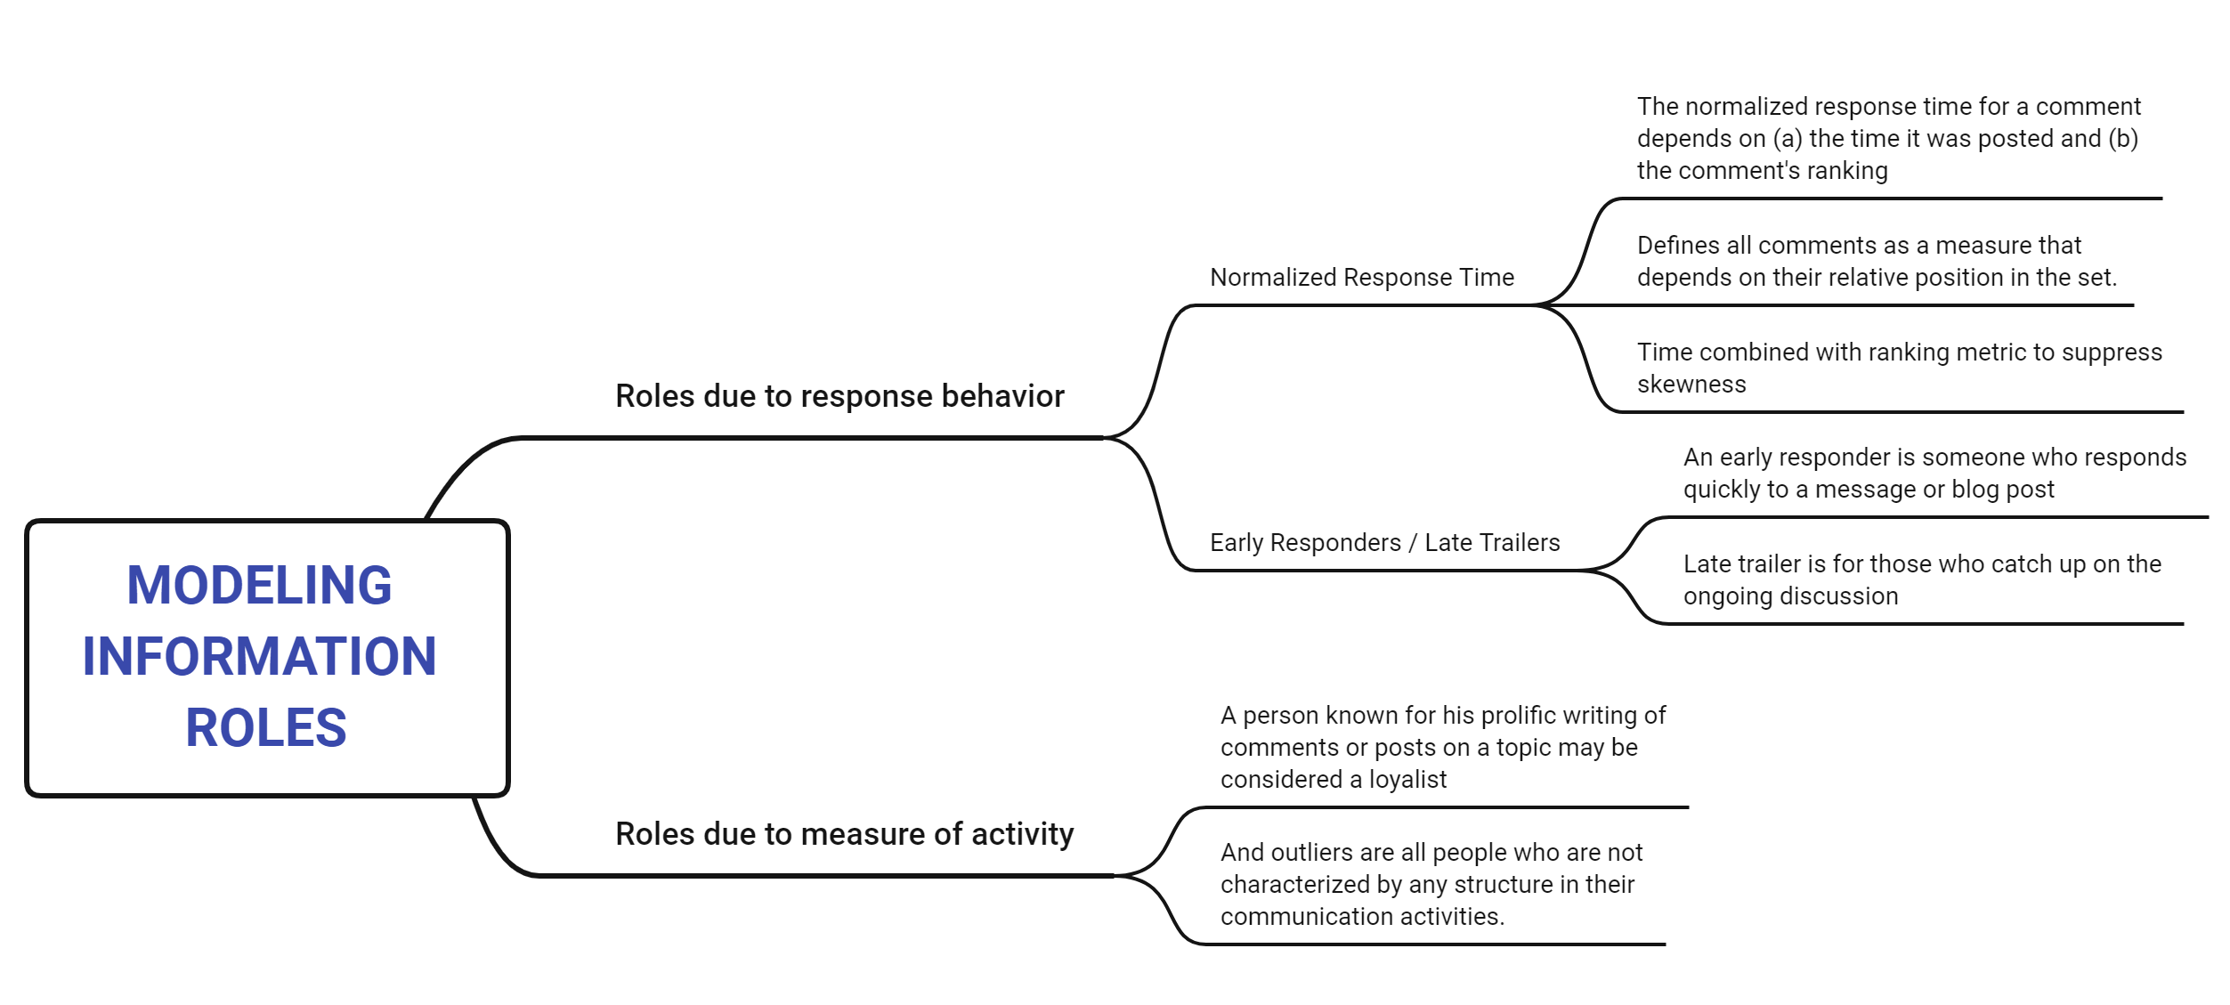
MODELING INFORMATION ROLES

Slide 4
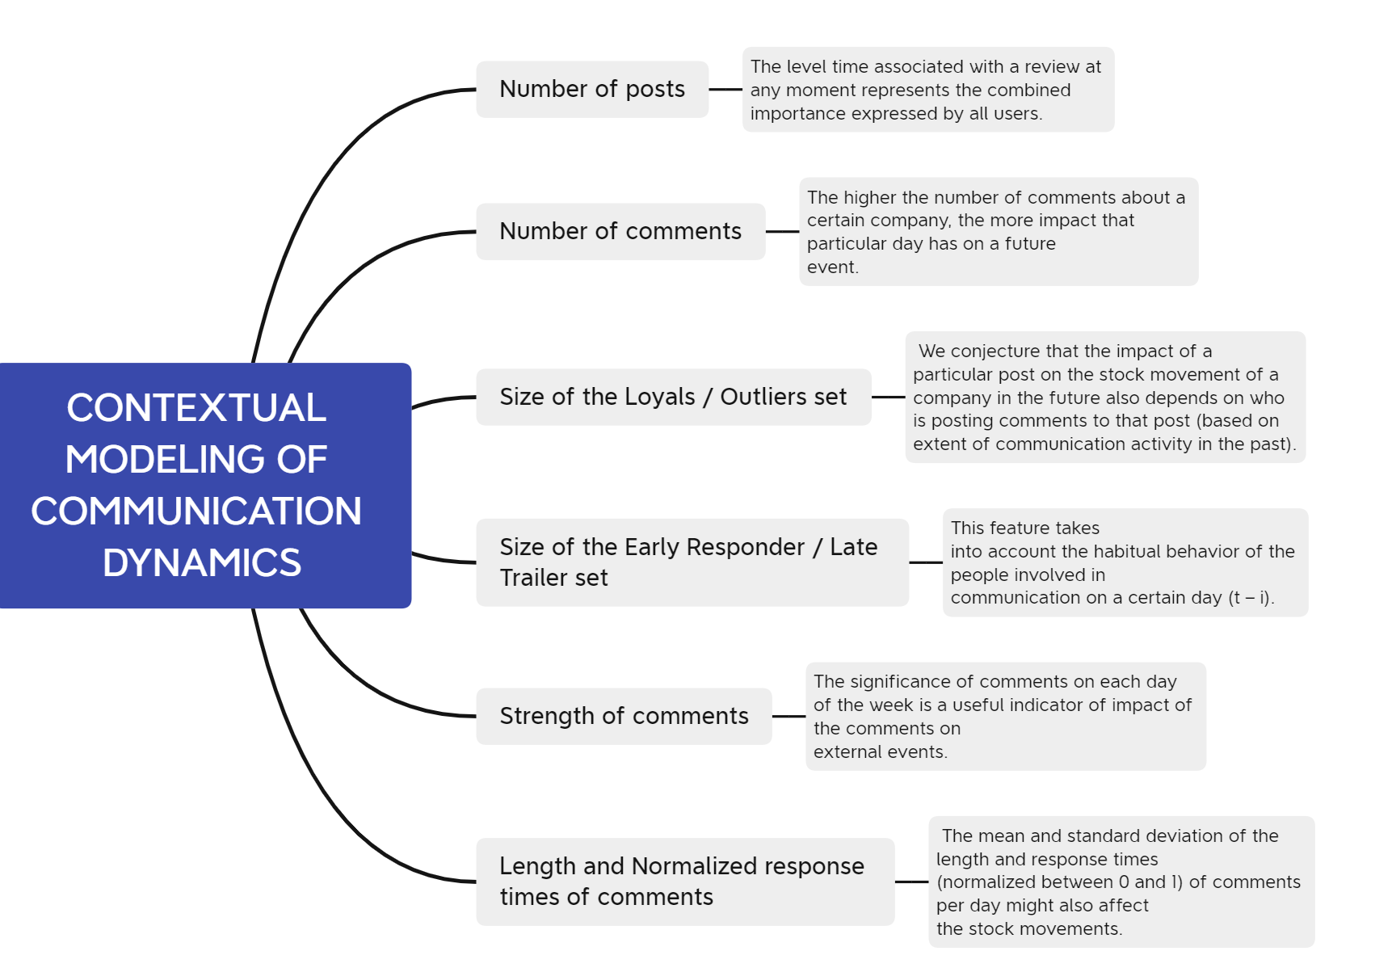
CONTEXTUAL MODELING OF COMMUNICATION DYNAMICS

Slide 5
DETERMINING CORRELATION
Highlights from what I read：
In order to determine their relevance to communication dynamics, it is important to consider that overall stock market sentiment is also affected. An SVM regression framework is proposed to predict stock movements.
EXPERIMENTAL RESULTS
We discuss our dataset and prediction results using SVR.
Two baseline methods and SVM regression technique are used.
We observe that both baseline methods fail to adequately capture the subtleties of stock movement changes. Only after an event has occurred the baseline method attempts to compensate for its "big" event by subsequently exhibiting greater movement. However, SVR is better able to capture fluctuations; as it can capture a wide range of contextual features and is also able to learn the relationships between them dynamically.

Slide 6
CONCLUSION
Highlights from what I read：
Would love to refine our analysis of information roles to identify people whose communication activities have different consequences. Contextual models can also refine company labels by merging clusters, characterizing areas by identifying responses to people and their reviews, etc.
Q1: How can the application of SVR in forecasting stock price movements be optimized to further enhance its ability to capture and predict fluctuations, especially in the context of 'big' events, by dynamically learning from a broad spectrum of contextual features and their interrelationships
A1: We can conclude that SVR (Support Vector Regression) is more effective in predicting stock market movements compared to baseline methods. This advantage mainly stems from SVR's ability to process a large number of contextual features and dynamically learn the relationships between these features.

